Slide 1
Measure the Value of Earth Observations
NASA’s Earth observing satellites capture data and information that help people better understand the planet, informing decisions that can lead to improved outcomes for society

Slide 2
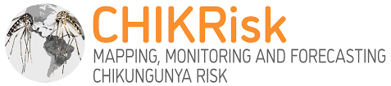
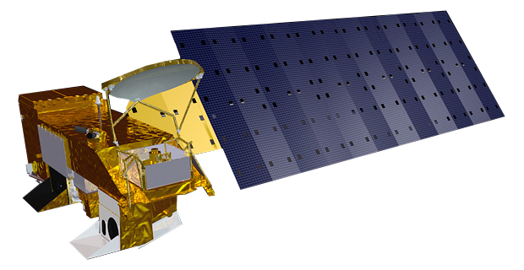
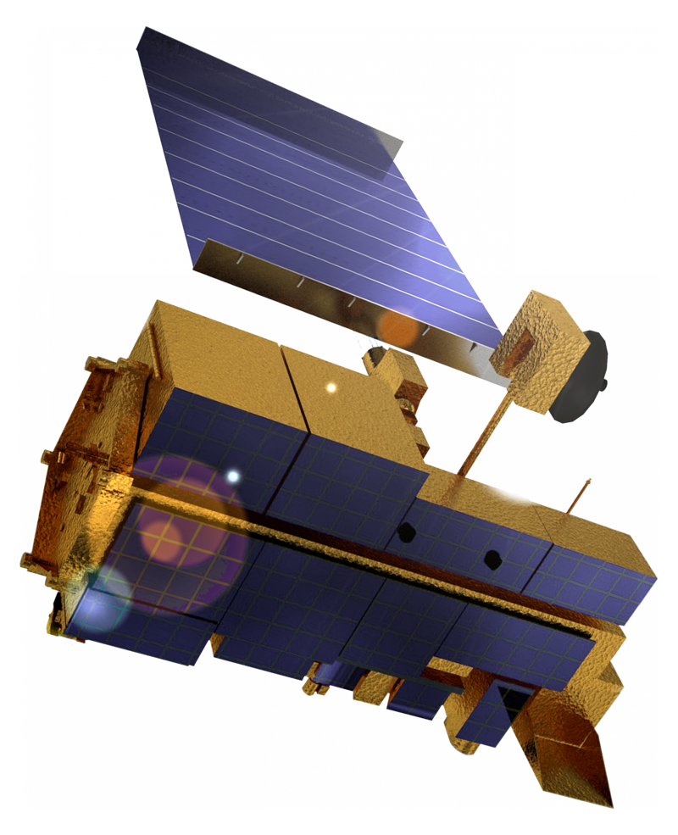
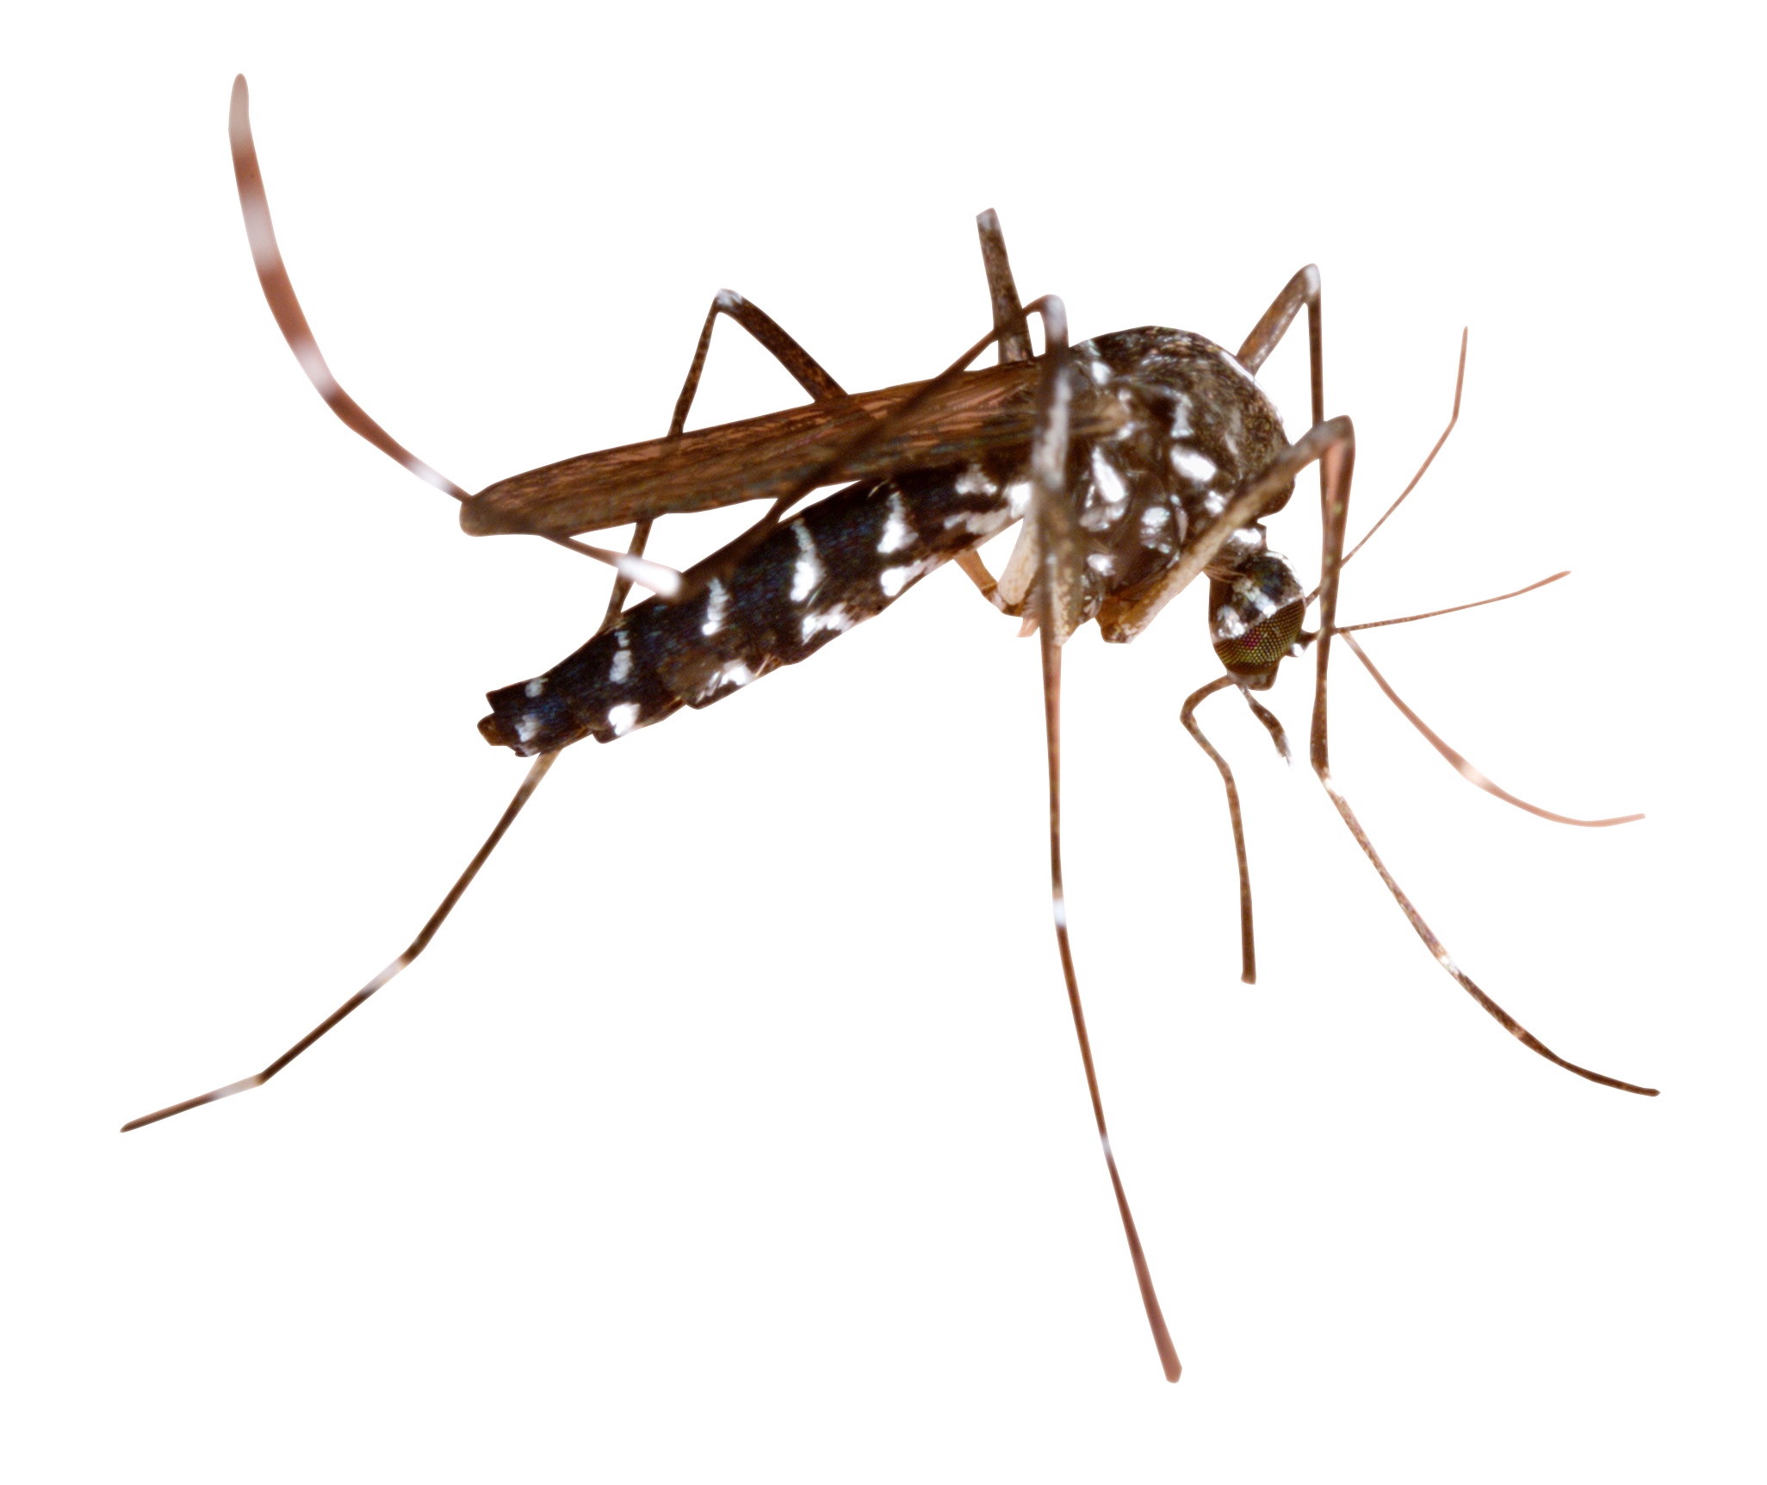
Health and Air Quality
. CHIKRisk is one platform, created by a NASA-funded team for the chikungunya virus. This virus, which is transmitted by Aedes mosquitoes, is rarely fatal, but often causes fever and debilitating joint pain. That is why the NASA team designed CHIKRisk App to be a publicly accessible mapping platform to monitor the chikungunya virus’ spread and provide climate-based risk maps for its occurrence up to three months in advance.
.Satellite data, like local temperature and vegetation conditions from the Moderate Resolution Imaging Spectroradiometer (MODIS) instrument on board NASA’s Terra and Aqua satellites, can offer decision-makers a better picture of where infected mosquitoes might be spreading the Malaria.
Terra and aqua satellites monitor vegetation and soil moisture, which can reveal where conditions are ripe for the growth of Coccidioides and the spread of arid dust. MODISnstruments also help track dust storms’ spread by detecting the light reflected from the tiny particles as they are swept across the country.

Slide 3
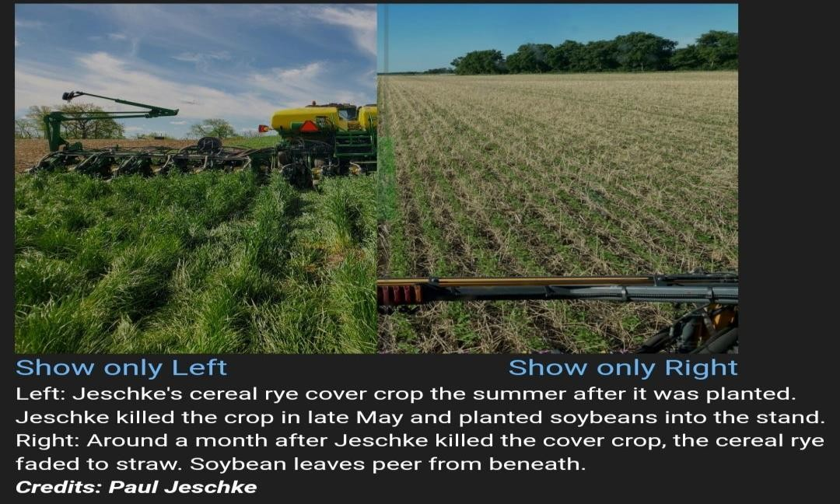
AGRICULTURE
The US Corn Belt is home to notions most productive soils.
Major problem faced by farmer is soil loss over the time.
NASA Satellites provide critical views of the region.
They’re helping scientists study soil loss over time and develop tools to support farmers as they adopt and manage conservation techniques.
Views from space help researchers study big-scale issues and measure the success of new ways of farming that helps keep soils healthy.
NASA’s MODIS, or Moderate Resolution Imaging Spectroradiometer, instruments on board the Terra and Aqua satellites, along with the joint NASA-U.S. Geological Survey’s Landsat satellites,
provide regular observations across the region.

Slide 4
WATER RESOURCES

Slide 5
TOPICS COVERED
.NASA DATA AND EARTH'S VITAL RESOURCE
.HOW DO WATER RESOURCES BENEFIT SOCIETY?
.HOW THE DATA INFORMATION THAT SATELLITES CAPTURE ABOUT WATER RESOURCES ON
.EARTH BENEFITS PEOPLE?
.HOW IS NASA HELPING IN IMPROVING WATER RESOURCES?
.USES OF NASA’S WATER DATASETS AND TECHNOLOGY
.IMPROVING WATER RESOURCES MANAGEMENT WITH SATELLITE DATA
.FUTURE OF WATER

Slide 6
NASA DATA AND EARTH'S VITAL RESOURCE
. Water is one of our most precious natural resources. But in many regions of the world, water supplies are under increasing pressure, and resource decisions are becoming more and more complex.
. The Water Resources program area helps discover, develop, and demonstrate new practical uses for NASA’s Earth observations in the water resources management community. We work with a wide range of partners in the United States and around the world to find innovative solutions as shifts in land use, changing climates and growing populations stress water supplies.

Slide 7
HOW DO WATER RESOURCES BENEFIT SOCIETY?
. Water resources are sources of water that are useful or potentially useful to humans.
. It is important because it is needed for life to exist.
. Many uses of water include agricultural, industrial, household, recreational and environmental activities.
. Virtually all of these human uses require fresh water.
. Only 2.5% of water on the Earth is fresh water, and over two thirds of this is frozen in glaciers and polar ice caps.
. Water demand already exceeds supply in many parts of the world, and many more areas are expected to experience this imbalance in the near future.
. It is estimated that 70% of world-wide water use is for irrigation in agriculture.
. Due to the expanding human population competition for water is growing such that many of the worlds major aquifers are becoming depleted.
. Many pollutants threaten water supplies, but the most widespread, especially in underdeveloped countries, is the discharge of raw sewage into natural waters.

Slide 8
HOW THE DATA INFORMATION THAT SATELLITES CAPTURE ABOUT WATER RESOURCES ON EARTH BENEFITS PEOPLE?
. Satellite data on water resources enables efficient mapping and monitoring of the Earth's resources, ecosystems, and events. The information can be used for various scientific, administrative and commercial applications.
. Satellites circle the Earth, so their imaging activity can be repeated easily. It also allows for much greater areas of coverage and, because all information is digital, it can be easily integrated with software.

Slide 9
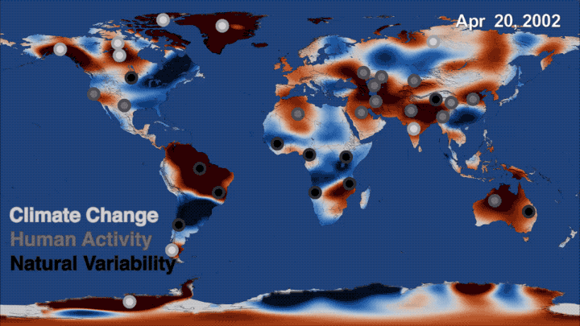
HOW IS NASA HELPING IN IMPROVING WATER RESOURCES?
. NASA and its partners are using satellites to revolutionize our ability to track and understand the flow of freshwater around Earth – whether it is in the atmosphere, at the Earth's surface, or underground. ... On the ground, freshwater is stored in ice, snow, rivers and lakes.
NASA has been on the path to achieve long-term sustainability goals for many years through numerous efforts in energy conservation, recycling, water management, pollution prevention, design and construction, maintenance and operations, master planning, and electronic stewardship.

Slide 10
USES OF NASA’S WATER DATASETS AND TECHNOLOGY
. Whether concerned with floods, droughts, or the status and quality of water supplies, addressing the water-related needs of humans on Earth starts with knowing where the water is. With unique views from space, NASA is at the forefront of studying and monitoring this most precious resource that is constantly on the move. Researchers use data from satellites, aircraft, and other efforts, to find out where and when water is available around the globe, how much, and how are those patterns changing. They then figure out how to best use that data and get it into the hands of the people who need it most.
. NASA and its partners are using satellites to revolutionize our ability to track and understand the flow of freshwater around Earth – whether it is in the atmosphere, at the Earth’s surface, or underground. In the last two decades, freely available NASA datasets have been used for extensive research into the movement, distribution, and interaction of each part of the water cycle worldwide.

Slide 11
SNOW :
NASA is improving on existing and developing new remote sensing methods that can reveal how much water is stored in mountain and seasonal snowpack – one of the world's most vital sources of freshwater.
SKY ( RAINFALL ) :
Rainfall data is one of the most essential tools for monitoring freshwater's movement around the planet, and goes into applications that touch people's everyday lives, including weather forecasting, crop monitoring, and flood prediction. For many parts of the world, especially developing countries and hard-to-reach terrain where ground measurements are sparse to non-existent, these global NASA datasets are sometimes the only consistent source of information on rainfall and soil moisture.
UNDERGROUND WATER:
NASA satellites monitoring Earth's gravity field have given scientists insight into the movement of large masses such as ice and water – including water hidden underground. Of the 37 largest aquifers on Earth, a third of them are being depleted by communities pumping the water faster than it recharges from rainfall.

Slide 12
IMPROVING WATER RESOURCES MANAGEMENT WITH SATELLITE DATA
. Sustainable water resource management is a central challenge for governments the world over. Extremes in the water cycle, namely, floods and droughts, strain even the wealthiest nations and devastate vulnerable populations. Furthermore, many of the most water vulnerable places on Earth are also the most hydrologically data poor.
. To make up for a shortage of water data, a consequence of limited in situ monitoring networks, many scientists and water managers in low-income countries rely on remotely sensed data acquired from satellites. After decades of maturation, satellite-based sensors orbiting Earth can now measure precipitation, evaporation, surface water levels, soil moisture, snow depth, groundwater etc

Slide 13
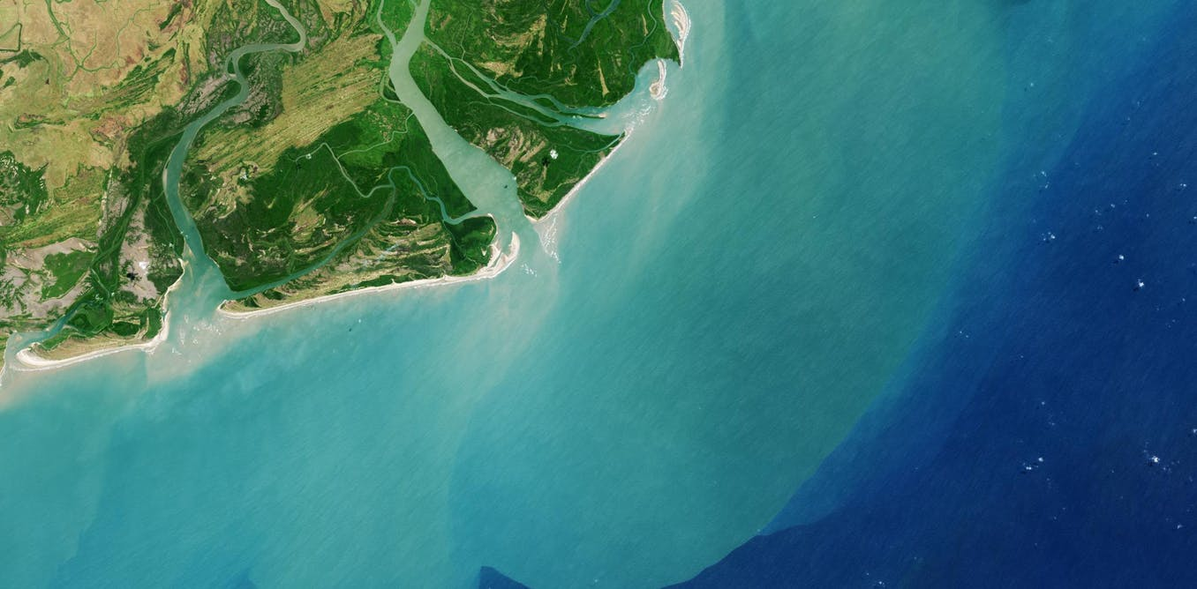
FUTURE OF WATER:
Upcoming remote sensing missions promise to further progress water management. For instance, NASA’s proposed Hyperspectral Infrared Imager (HyspIRI) could improve analyses of snow and vegetation conditions. Meanwhile, China’s Water Cycle Observation Mission (WCOM), set to launch in 2020, aims to advance measurements of soil moisture, freeze-thaw cycles, and precipitation. Several other missions slated for launch in the next few years will contribute even more water-related data.
A new generation of satellite sensors will also require novel solutions to help water managers adapt to new data formats and procedures. The authors note that investment in training programs will be essential to furthering the use of remote sensing in water management.

Slide 14
CAPACITY BUILDING

Slide 15
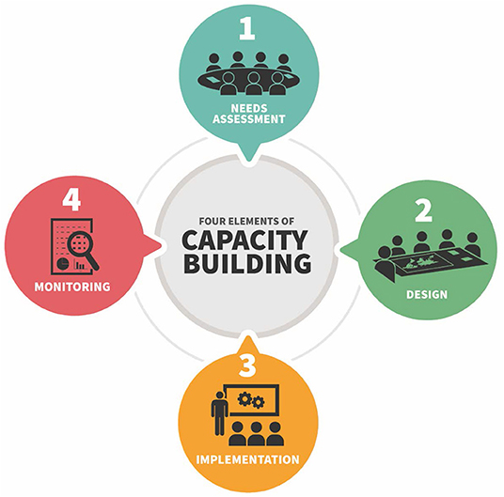
. THE CAPACITY BUILDING PROGRAM PROVIDES INDIVIDUALS AND INSTITUTIONS WITH
WORKFORCE DEVELOPMENT, TRAINING ACTIVITIES, AND COLLABORATIVE PROJECTS TO
STRENGTHEN UNDERSTANDING OF EARTH ObSERVATIONS AND EXPAND THEIR USE AROUND THE
WORLD. THROUGH OUR ARSET, DEVELOP AND SERVIR PROGRAMS AND OUR INDIGENOUS
PEOPLE’S PILOT PROJECT, WE WORK WITH EVERYONE AT EVERY LEVEL- FROM FirST-TIME
USERS TO LONG-TIME PROFESSIONAL USERS.
MAKING EARTH DATA ACCESSIBLE TO ALL
. INDIGENOUS PEOPLES PILOT SUPPORt ANYONE WHO IS INTERESTED
IN LEARINING about Earth observations and remote sensing
technologies.
. MANY INTERNATIONAL ORGANISATIONs LIKE THE NATIONAL PARK
SERVICE, VIRGINIA’S CITY OF HAMPTON, THE WORLD FOOD
PROGRAMME, THE INTERNATIONAL GROUP ON EARTH
OBSERVATIONS(GEO) AND MANY OTHERS, MAKE SURE THAT they
CONNECT WITH ANYONE INTERESTED IN INCORPORATING EARTH
OBSERVATION INTO THEIR WORK.

Slide 16
. IDENTIFYING DROUGHT PRONE AREAS AND DEVELOP AN EARLY WARNING SYSTEM FOR CROP DAMAGE. PROTECTING BIOLOGICALLY DIVERSE AREAS OF THE NATIONAL PARK SYSTEM WITH A TRAIL MONITORING TOOL. CONFIRMING FLOODED AREAS TO BETTER INFORM DECISION MAKERS DURING A DISASTER.
. PORTFOLIO DEMONSTRATES THE BENEFITS OF USING NASA Earth OBSERVATION TO ENHANCE DECISION MAKING AND IMPROVE LIFE ON EARTH.
Project portfolio

Slide 17
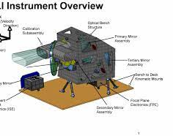
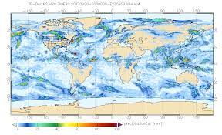
1. AFRICA FOOD SECURITY AND AGRICULTURE
. HUMAN-WILDLIFE CONFLICT IS INCREASINGLY MORE COMMON DUE TO HUMAN POPULATION GROWTH, HABITAT FRAGMENTATION, AND CHANGING CLIMATIC CONDITIONS. THIS CONFLICT IS PARTICULARLY EVIDENT IN THE KAVANGO-ZAMBEZI AREA BECAUSE OF DROUGHT SEVERITY AND SCARCE FOOD AVAILABILITY, WHERE OVER THREE MILLION PEOPLE SHARE THE LANDSCAPE WITH AN ABUNDANT MEGAFAUNA POPULATION. THIS conflict between elephants and humans has resulted in crop loss, property damage, and threats to public safety.
. In order to manage current and future conflict, The Ecoexist Project and Connected Conservation have been working to empower farmers and conserve natural habitat. This DEVELOP project employed Earth observations to conduct a time series analysis of vegetation health change, elephant movement, and climate conditions, from 2017 to 2020. Data wAS aggregated into half-year seasons: the wet season (November through April) and the dry season (May through October). The resulting analysis demonstrated the potential to use Landsat 8 Operational Land ImagER(OLI)
SOME OF THE EXAMPLES.

Slide 18
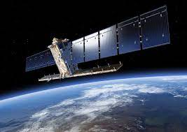
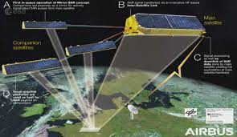
Artisanal and small-scale gold mining (ASGM) is responsible for a large fraction of deforestation and disturbance in Amazonia WHICH cause severe impacts on the rainforest ecosystem and socioeconomic state of the region.
NASA DEVELOP partnered with the Asociación para la Conservación de la Cuenca Amazónica (ACCA), NASA SERVIR Science Coordination Office, and the Spatial Informatics Group to enhance ASGM-related deforestation detection methods. The team determined the algorithm's accuracy by comparing random sampleS of change points against data identified using PlanetScope and Landsat 8 OLI Earth observations through ‘Collect Earth’ Online.
This research can have a more accurate understanding of where illegal gold mining may be taking place and inform decisions to remediate this activity.
2.AMAZONIA DISASTERS

Slide 19
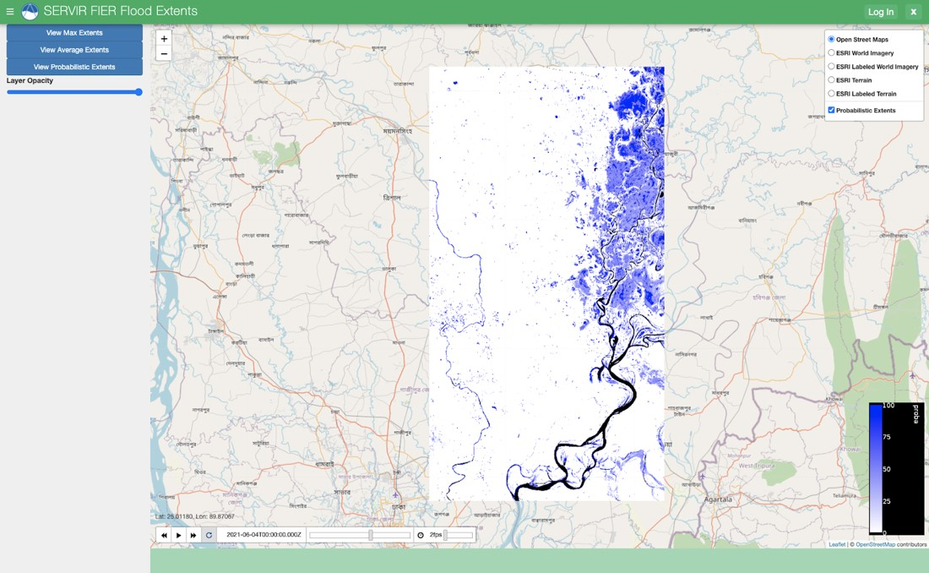
.A promising approach to mitigating the economy and human costs of flooding is to apply information from earth observing satellites and reduce a community’s risk before a flood happens, as flooding causes millions of dollars in economic costs and often affects more vulnerable communities.
.Servir is a joint initiative between nasa and us agency for international development(usaid). It partners with leading regional organisations around the world to help developing countries use earth observing data to manage environment risks and land use.
SOME NEWS
Using SAR to create flood mapping tools .

Slide 20
Weather is defined as the short-term, current atmospheric conditions of any given location. In contrast, climate is the long term average of these conditions in that same location THROUGHOUT DECADES AND MILLENNIA.
PREVIOUSLY THE CLIMATE WAS DETERMINED BY A PERSON MANUALLY TAKING THE TEMPERATURE ENTRIES OF A LOCATION But nowadays these are being done with by satellites, recording the whole picture from space. Polar-orbiting and geostationary satellites are constantly measuring the temperature, precipitation, and all the other variables that go into our planet’s climate. With this information, we can then make informed choices In term of our adaptation and risk management.
For the first time, arset will train the public on the use of nasa satellites for climate change.

